Slide 1
Sparse MRI:
The Application of Compresses Sensing for Rapid MR Imaging

Slide 2
1. Figures
1.1. Figure 2
1.2. Figure 4
1.3. Figure 3
1.4. Figure 6
2. CS SENSE

Slide 3
1.
Figures

Slide 4
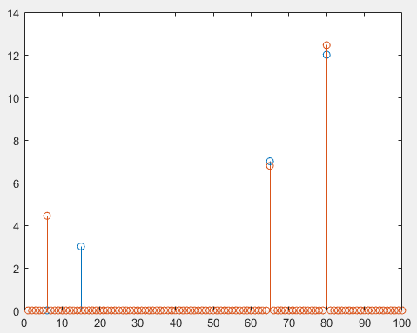
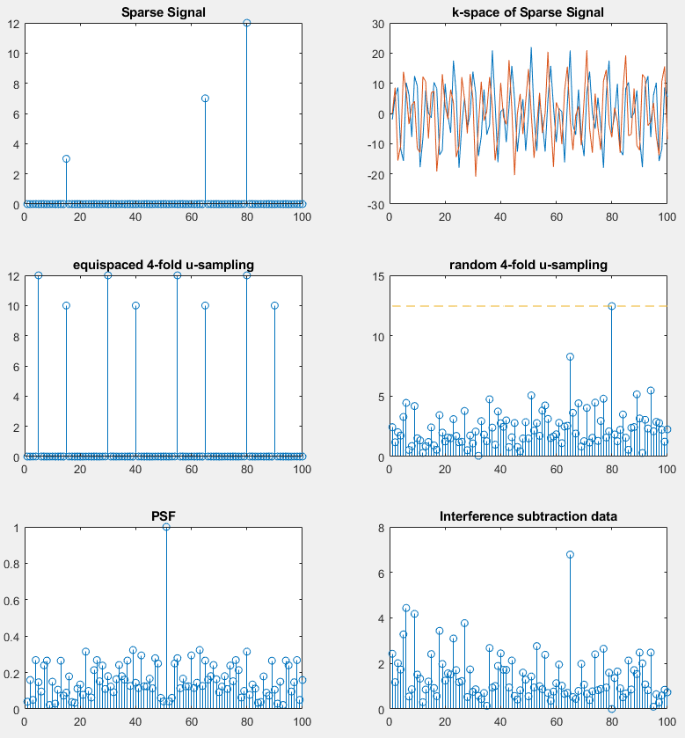
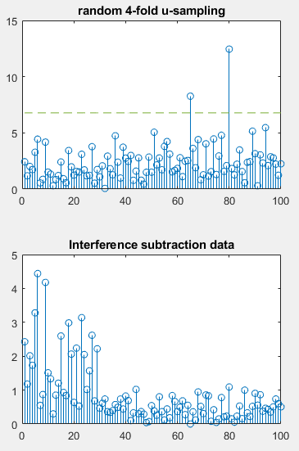
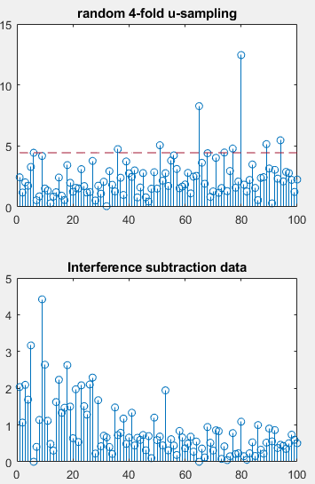
1.1. Figure 2

Slide 5
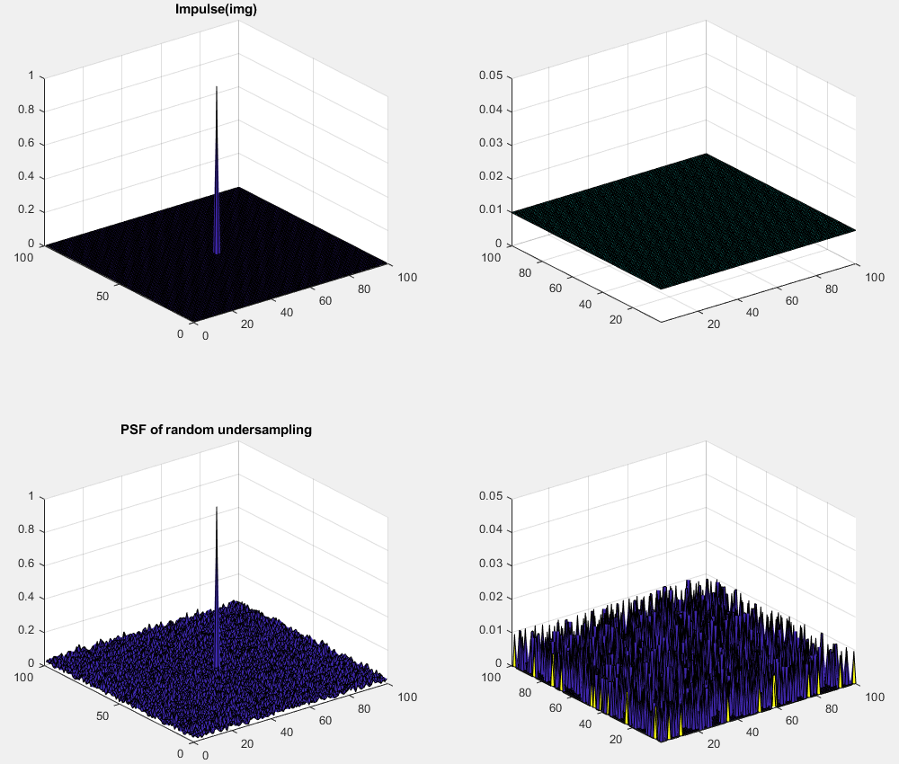
1.2. Figure 4
PSF(Point Spread Function)
FT
Random
undersampling
IFT
The data acquisition speed of MRI is circumscribed by physical(gradient amp) and physiological(nerve stimulation) constraints. Therefore, many researches are seeking for methods to reduce the amount of acquired data without degrading the image quality.

Slide 6
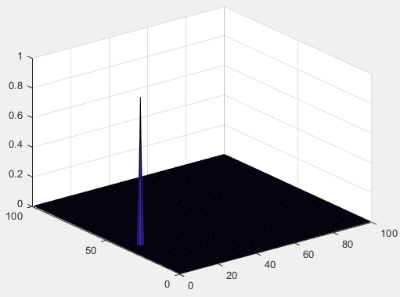
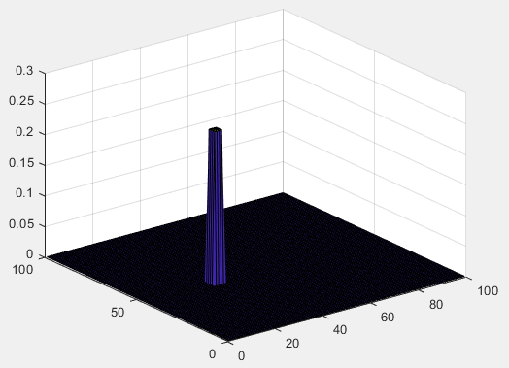
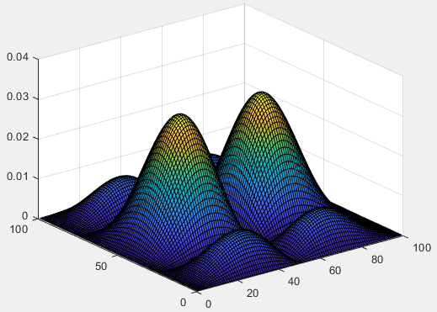
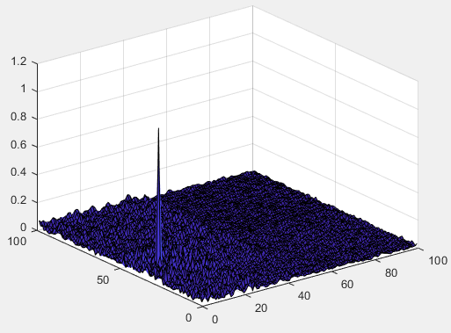
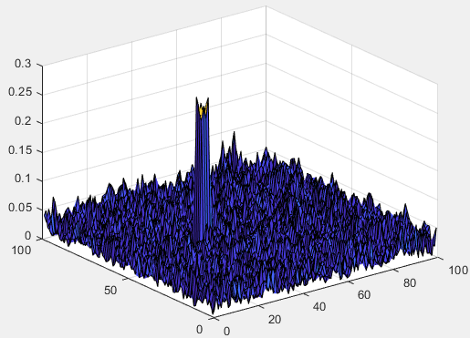
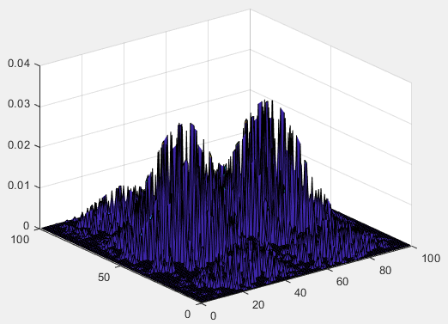
1.2. Figure 4
The wavelet TPSF(Transform Point Spread Function)
IDWT
FFT
Random
undersampling
FDWT
IFFT

Slide 7
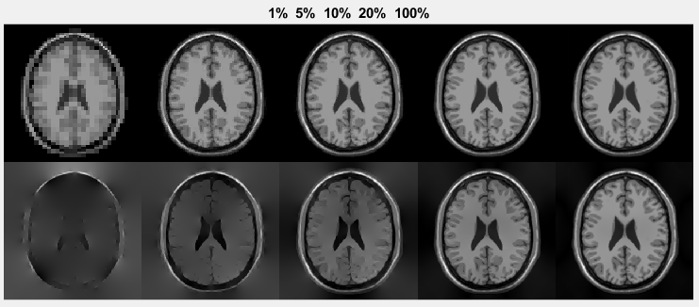
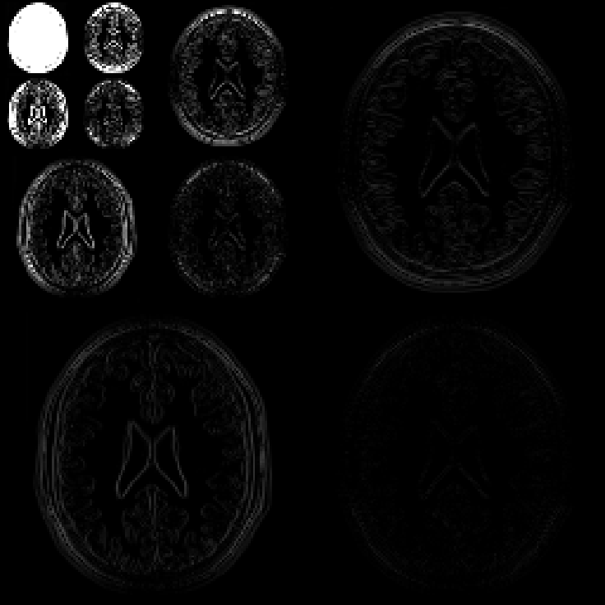
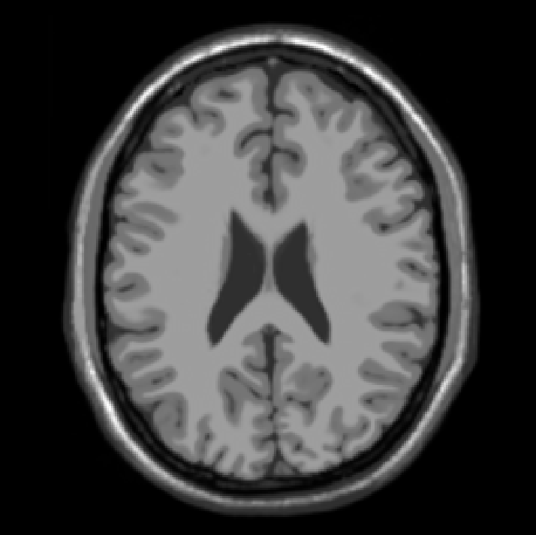
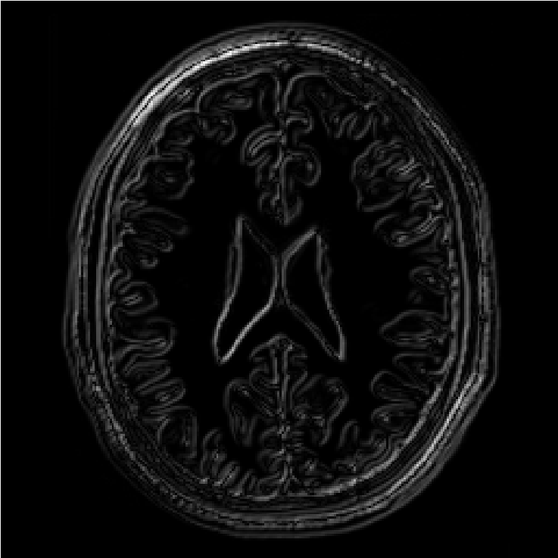
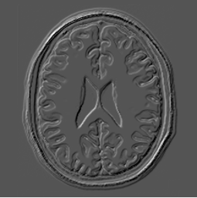
1.3. Figure 3
Transform-domain sparsity of images
Reference
Wavelet
Finite diff.

Slide 8
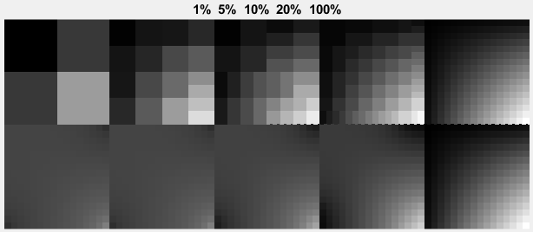
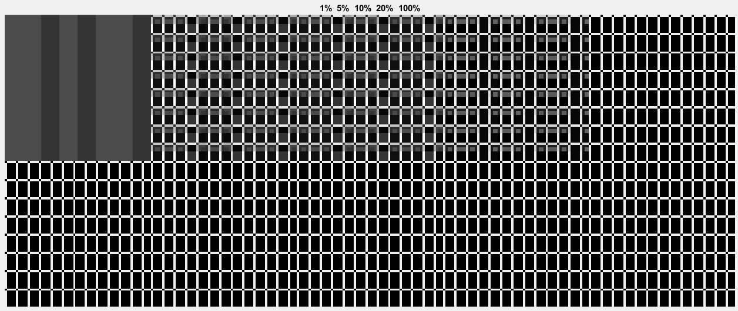
1.3. Figure 3

Slide 9
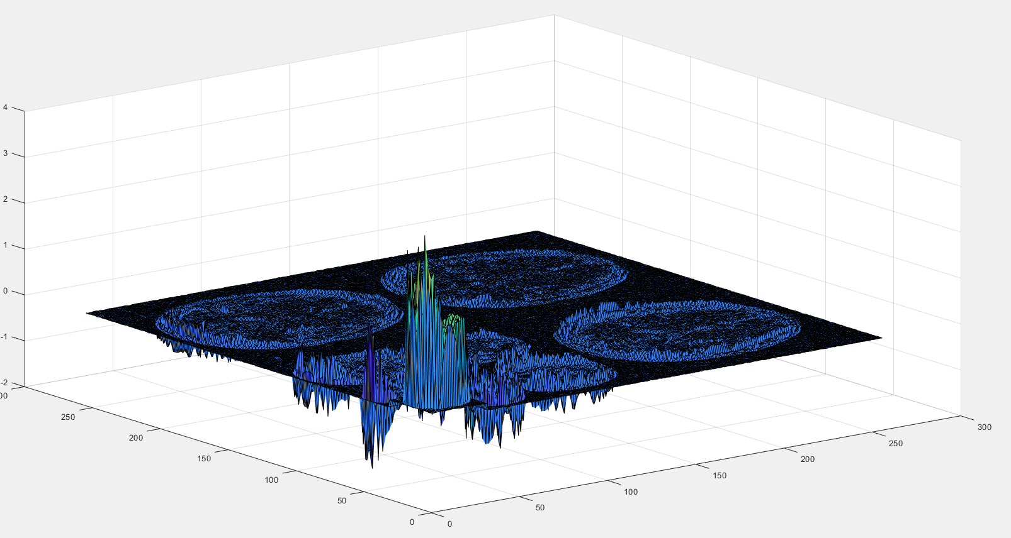
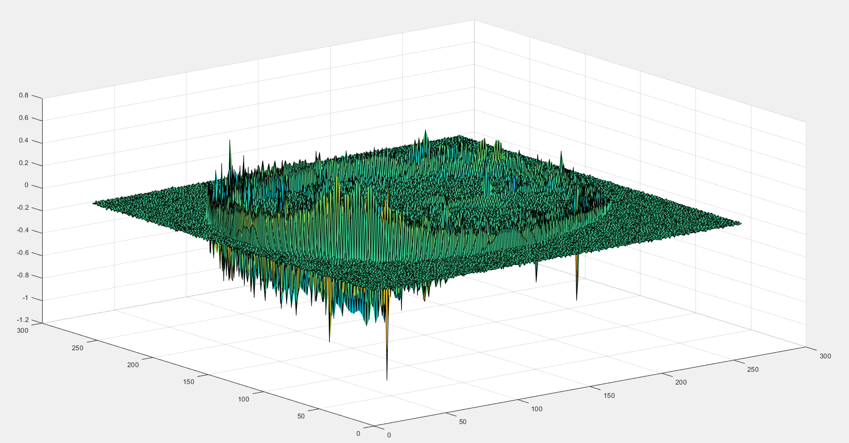
1.3. Figure 3

Slide 10
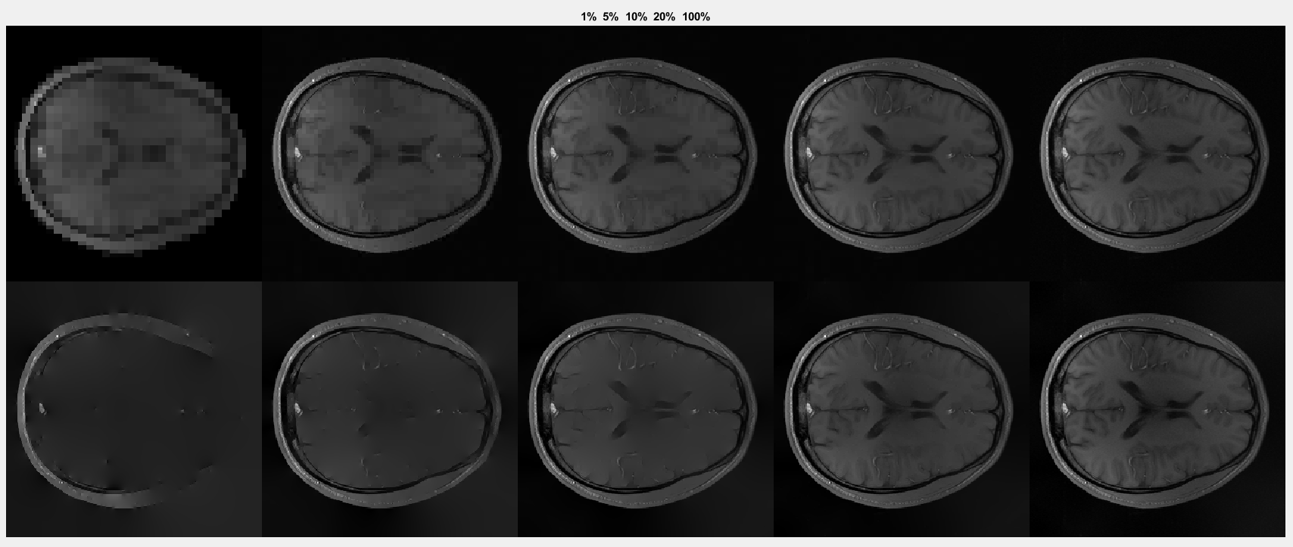
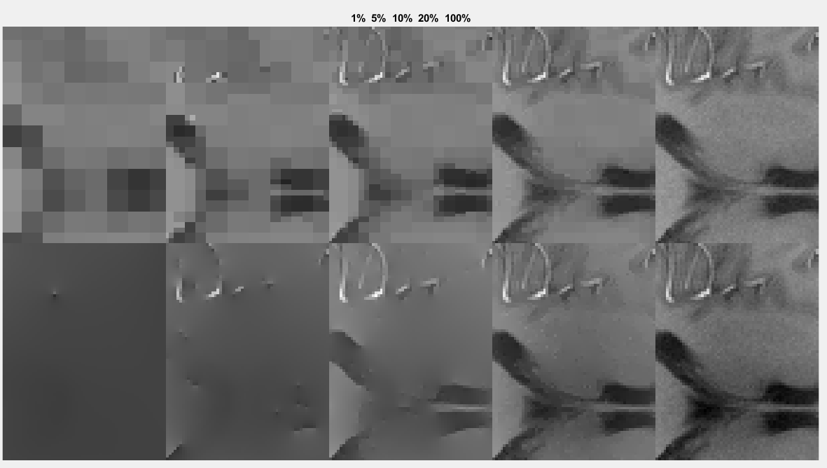
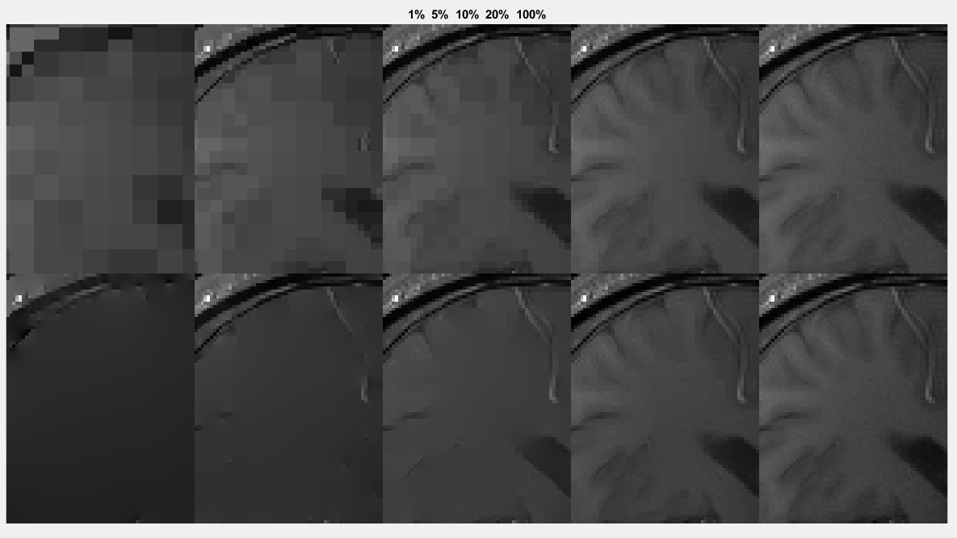
1.3. Figure 3
TV 가 smooth info를 잘 보전하는 것이 아니라, l1 minimization을 하면서 smooth한 entry가 날라가며 smoot에 weight를 더 주는 것이 아닌가.
+ TV 자체는 wavelet에 비해 sparsity ↓
But, l1 min으로 objective function을 세우면 smoothing property를 살릴 수 있음 => 이게 아닌가
+ l1 norm으로 인해 variance 가 적은 부분들이 날라가니까 edge가 아니라 ‘edge position’의 info만 남아짐

Slide 11
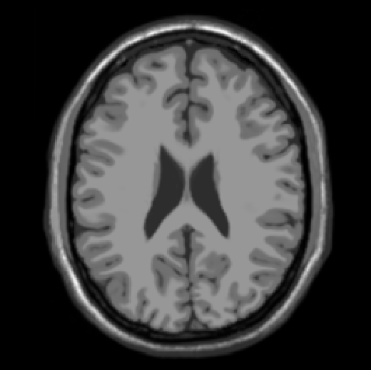
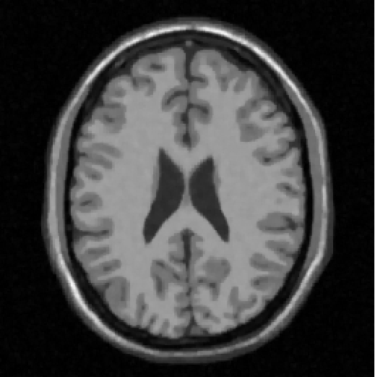
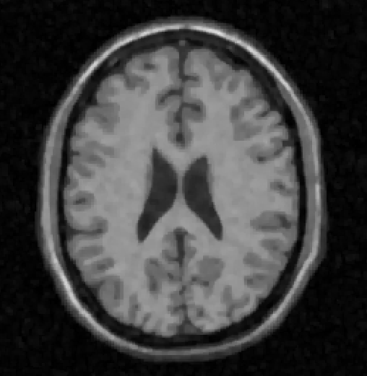
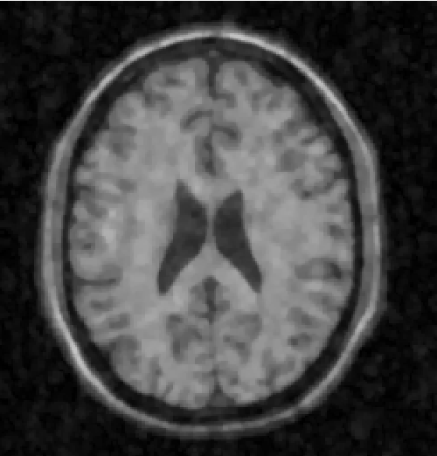
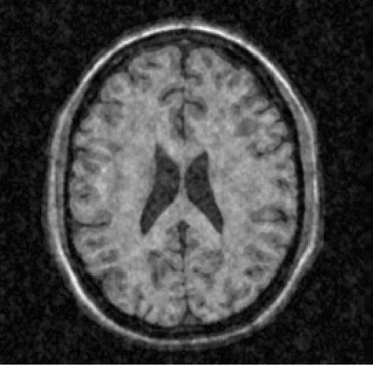
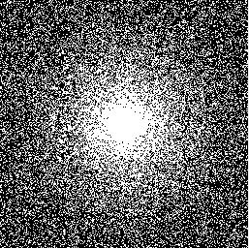
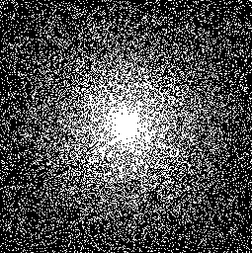
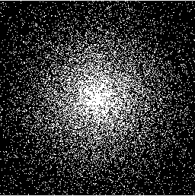
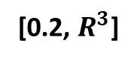
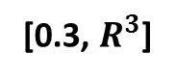
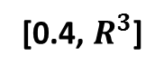
1.4. Figure 6
[Acquired data ratio, Density reduction factor]
[0.4, $R^{3}$]
[0.3, $R^{3}$]
[0.2, $R^{3}$]
Reconstruction
Reference
ZF-w/dc
Mask
Iteration : 20
Alpha = 0.05
Beta = 0.6
Smoothing factor : 1e-6
Wavelet weight = 1e-3
TV weight = 1e-3

Slide 12
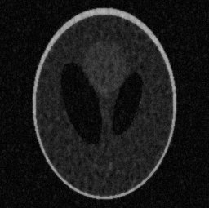
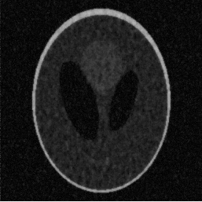
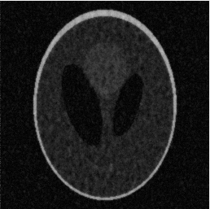
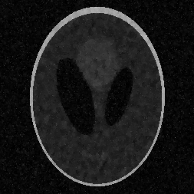
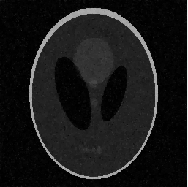
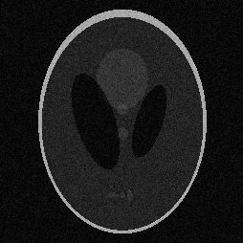
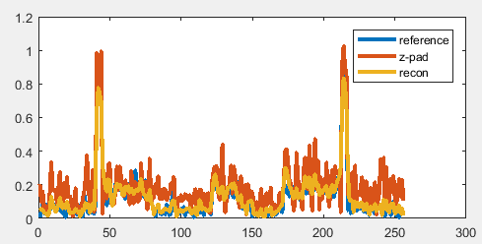
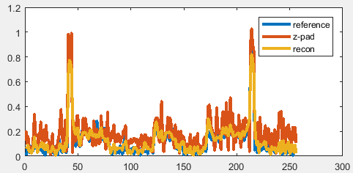
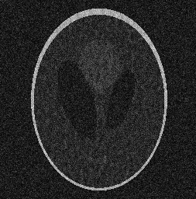
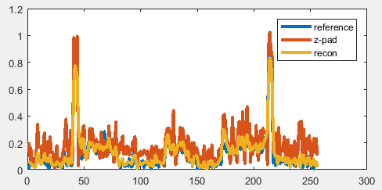


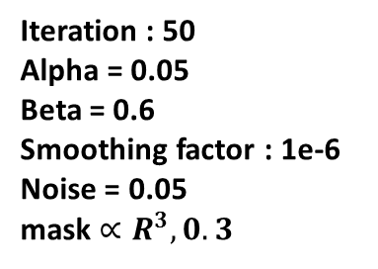
1.4. Figure 6
A
B
C
D
E
wav weight = 0
TV weight = 0
wav weight = 1e-2
TV weight = 0
wav weight = 1e-4
TV weight = 0
wav weight = 1e-3
TV weight = 1e-3
wav weight = 1e-3
TV weight = 1e-2
Reference
A
B
ZF w/dc
Iteration : 50
Alpha = 0.05
Beta = 0.6
Smoothing factor : 1e-6
Noise = 0.05
mask $∝R^{3}, 0.3$
C
D
E

Slide 13
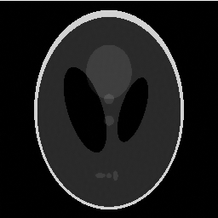
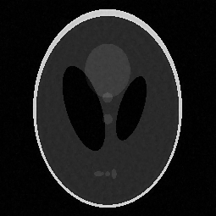
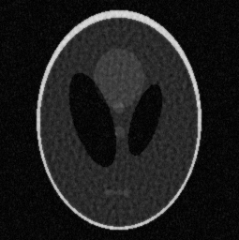
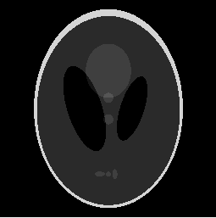
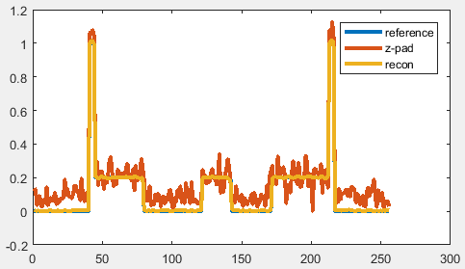




1.4. Figure 6
A
B
C
wav weight = 1e-3
TV weight = 1e-2
wav weight = 1e-3
TV weight = 1e-3
wav weight = 1e-3
TV weight = 1e-4
Reference
A
C
ZF w/dc
Iteration : 20
Alpha = 0.05
Beta = 0.6
Smoothing factor : 1e-6
mask $∝R^{3}, 0.3$
B

Slide 14














1.4. Figure 6
ZF-w/dc
[Acquired data ratio,
Density reduction factor]
mask $∝R^{3}, 0.3$
[0.3,$R^{3}$]
Reference
Iteration : 20
Alpha = 0.05
Beta = 0.6
Smoothing factor : 1e-6
Wavelet weight = 1e-3
TV weight = 1e-2
[0.2,$R^{3}$]
[0.1,$R^{5}$]

Slide 15















1.4. Figure 6
wav weight = 0
TV weight = 0
wav weight = 1e-3
TV weight = 5e-4
wav weight = 1e-3
TV weight = 8e-4
Reference
wav weight = 1e-2
TV weight = 0
wav weight = 1e-3
TV weight = 3e-3
wav weight = 1e-3
TV weight = 5e-3
Iteration : 80
Alpha = 0.05
Beta = 0.6
Smoothing factor : 1e-6
mask $∝R^{1}, 0.5$
wav weight = 1e-3
TV weight = 0
wav weight = 1e-4
TV weight = 0
wav weight = 1e-3
TV weight = 1e-5
wav weight = 1e-3
TV weight = 1e-4
wav weight = 1e-3
TV weight = 1e-3
wav weight = 1e-3
TV weight = 1e-2

Slide 16



1.4. Figure 6
Reference
wav weight = 1e-3
TV weight = 3e-3
Iteration : 80
Alpha = 0.05
Beta = 0.6
Smoothing factor : 1e-6
mask $∝R^{2}, 0.4$

Slide 17





1.4. Figure 6
Reference
wav weight = 1e-3
TV weight = 3e-3
wav weight = 1e-3
TV weight = 2e-3
wav weight = 1e-3
TV weight = 1e-3
Iteration : 80
Alpha = 0.05
Beta = 0.6
Smoothing factor : 1e-6
mask $∝R^{2}, 0.3$

Slide 18







1.4. Figure 6
wav weight = 5e-4
TV weight = 3e-3
Reference
wav weight = 1e-3
TV weight = 3e-3
wav weight = 1e-3
TV weight = 2e-3
wav weight = 1e-3
TV weight = 1e-3
Iteration : 80
Alpha = 0.05
Beta = 0.6
Smoothing factor : 1e-6
mask $∝R^{3}, 0.25$
wav weight = 2e-3
TV weight = 3e-3

Slide 19





1.4. Figure 6
Reference
wav weight = 1e-3
TV weight = 3e-3
wav weight = 1e-3
TV weight = 2e-3
Iteration : 80
Alpha = 0.05
Beta = 0.6
Smoothing factor : 1e-6
mask $∝R^{3}, 0.2$
wav weight = 2e-3
TV weight = 3e-3

Slide 20



1.4. Figure 6
Reference
wav weight = 1e-3
TV weight = 3e-3
Iteration : 80
Alpha = 0.05
Beta = 0.6
Smoothing factor : 1e-6
mask $∝R^{5}, 0.1$

Slide 21


2.
CS SENSE
Sparse MRI :
CS SENSE :

Slide 22


1.4. Figure 6
Ground Truth
Sparse SENSE
CS SENSE
wav weight = 1e-3
TV weight = 3e-3
wav weight = 1e-3
TV weight = 3e-3
Iteration : 80
Alpha = 0.05
Beta = 0.6
Smoothing factor : 1e-6
mask $∝R^{1}, 0.5$

Slide 23


1.4. Figure 6
Ground Truth
Sparse SENSE
CS SENSE
wav weight = 1e-3
TV weight = 1e-3
wav weight = 1e-3
TV weight = 3e-3
Iteration : 80
Alpha = 0.05
Beta = 0.6
Smoothing factor : 1e-6
mask $∝R^{2}, 0.4$

Slide 24


1.4. Figure 6
Ground Truth
Sparse SENSE
CS SENSE
wav weight = 1e-3
TV weight = 3e-3
wav weight = 1e-3
TV weight = 3e-3
Iteration : 80
Alpha = 0.05
Beta = 0.6
Smoothing factor : 1e-6
mask $∝R^{2}, 0.3$

Slide 25


1.4. Figure 6
Ground Truth
Sparse SENSE
CS SENSE
wav weight = 1e-3
TV weight = 3e-3
wav weight = 1e-3
TV weight = 3e-3
Iteration : 80
Alpha = 0.05
Beta = 0.6
Smoothing factor : 1e-6
mask $∝R^{3}, 0.25$

Slide 26




1.4. Figure 6
CS SENSE
Sparse SENSE
Ground Truth
wav weight = 1e-3
TV weight = 3e-3
wav weight = 2e-3
TV weight = 3e-3
Iteration : 80
Alpha = 0.05
Beta = 0.6
Smoothing factor : 1e-6
mask $∝R^{3}, 0.2$
wav weight = 1e-3
TV weight = 2e-3
wav weight = 1e-3
TV weight = 3e-3

Slide 27

1.4. Figure 6
SparseSENSE
CS SENSE
Reference
wav weight = 1e-3
TV weight = 3e-3
wav weight = 2e-3
TV weight = 3e-3
Iteration : 80
Alpha = 0.05
Beta = 0.6
Smoothing factor : 1e-6
mask $∝R^{5}, 0.1$

